Slide 1
Using a deployment template to implement Azure virtual networks
Creating an Azure virtual network by using a deployment template
Creating a virtual network by using PowerShell
Configure virtual networks

Slide 2
Creating an Azure virtual network by using a deployment template
In the portal, click +New > Networking > Virtual network. On the Create virtual network blade, enter the following values, and then click Create:
In the portal, you can create only one subnet when you create a virtual network. In this tutorial, you create a second subnet after you create the virtual network. You might later create Internet-accessible resources in the Public subnet. You also might create resources that aren't accessible from the Internet in the Private subnet.
To create the second subnet, in the Search resources box at the top of the page, enter myVnet. In the search results, click myVnet. If you have multiple virtual networks with the same name in your subscription, check the resource groups that are listed under each virtual network. Ensure that you click the myVnet search result that has the resource group my Resource Group. On the myVnet blade, under SETTINGS, click Subnets. On the myVnet - Subnets blade, click +Subnet. On the Add subnet blade, for Name, enter Private. For Address range, enter 10.0.1.0/24. Click OK. On the myVnet - Subnets blade, review the subnets. You can see the Public and Private subnets that you created.

Slide 3
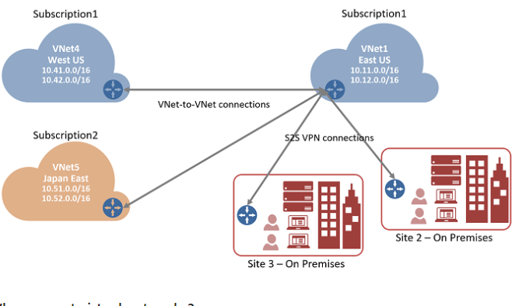
Creating a virtual network by using PowerShell
To create a virtual network using PowerShell, complete the following steps:
1. Install and configure Azure PowerShell
2. Create a new VNet named TestVNet
3. Store the virtual network object in a variable
4. Add a subnet to the new VNet variable
5. Although you create subnets, they currently only exist in the local variable used to retrieve the VNet you create in step 4 above. To save the changes to Azure, run the following command:
Set-AzureRmVirtualNetwork -VirtualNetwork $vnet

Slide 4
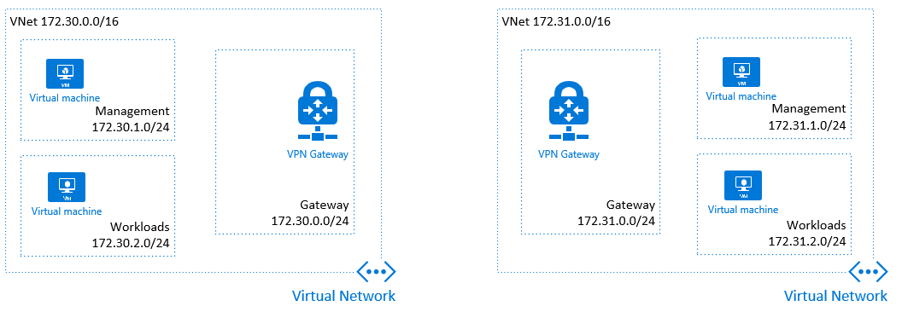
Configure virtual networks
Use the network configuration-XML to configure virtual networks that connect KVM virtual
servers among themselves and to an external network.
KVM hosts on IBM® Z support networks with three types of Linux bridges. All types make a
Communication setup addressable as a network or bridge.
Bridge with network address translation (NAT)
Open vSwitch bridge
Bridge with IP routing
Each bridge type has a different forwarding mode as specified with the <forward> element.
Omitting the <forward> element results in a virtual network among the virtual servers,
without a connection to a physical network.

